Slide 1
4-Step Learning System: CHINESE
(Description )

Slide 2
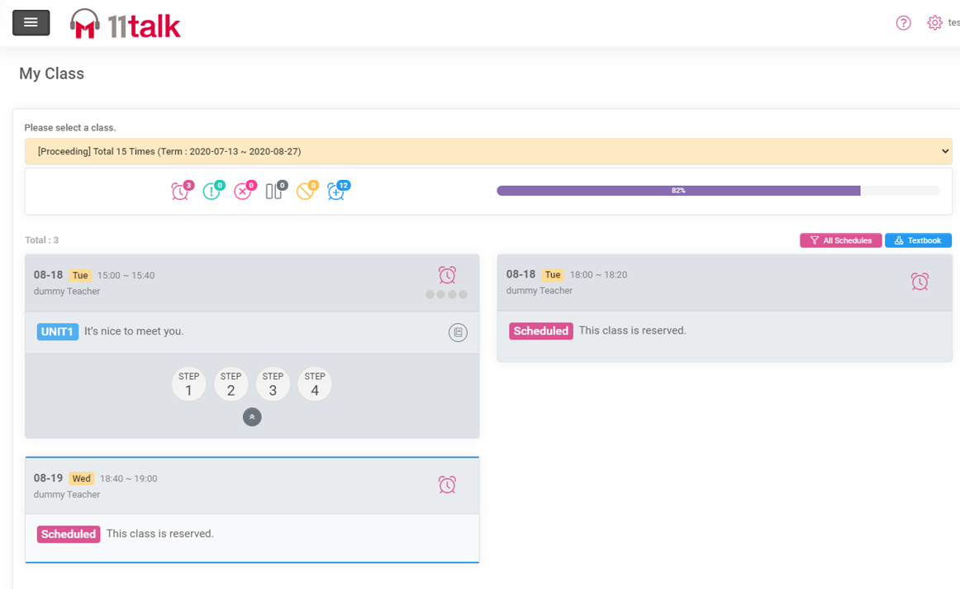

Systematic and Effective Learning Method
高效的线上课学习系统
11talk的四步学习方法旨在提高学生的听、说、读、写四个英语能力，并取得成绩
11talk's 4-step learning method has created great results in improving students' English macro skills from listening, writing, and reading, and speaking.

Slide 3
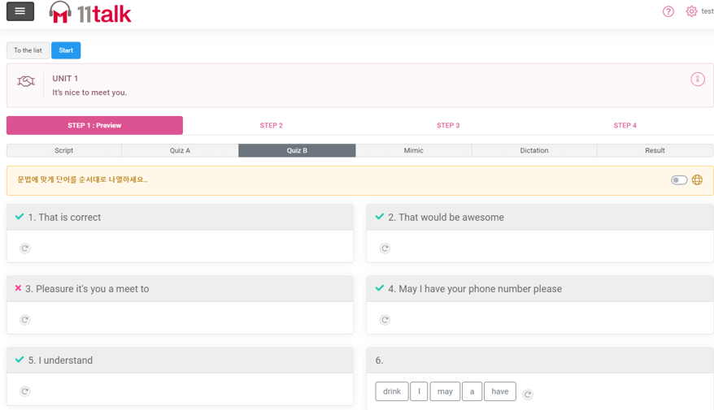
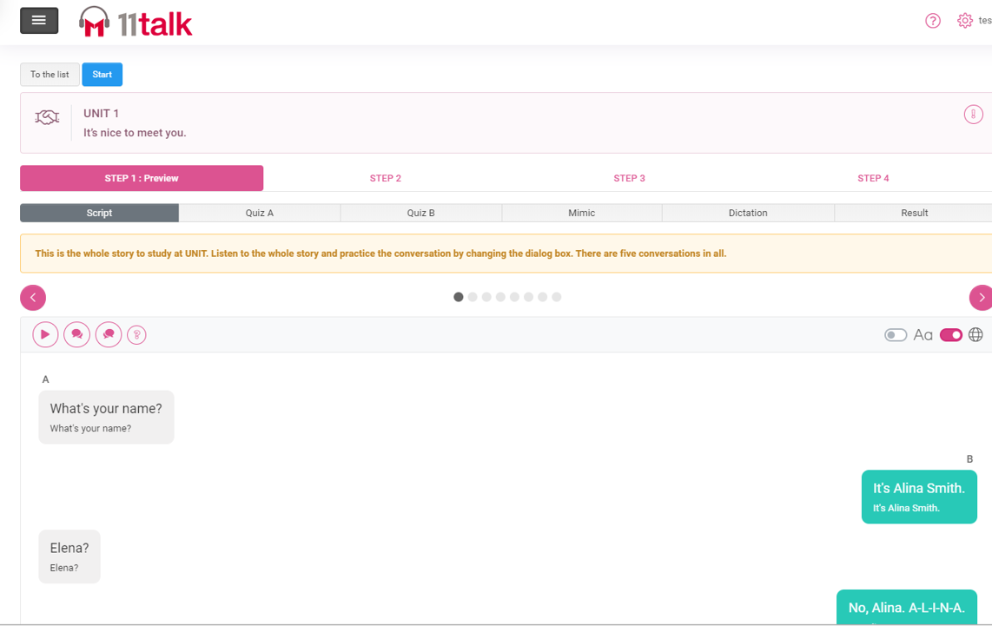
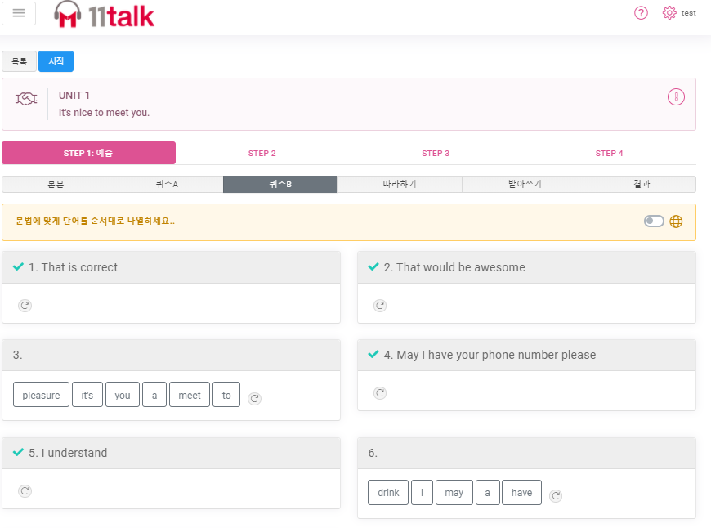
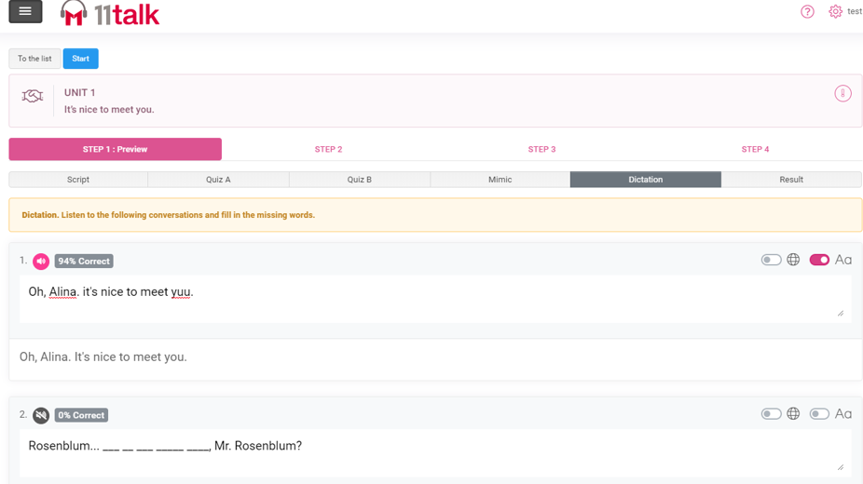

Step 1(Preview): Learn vocabulary and expressions before the class through initial quizzes, English audio files, and follow-up conversations.
步骤1（预习）：在上课之前，通过初步测验，英语录音档等文件以及后续对话来学习词汇和表达方式。
您可以通过听录音档为下一堂的课程练习新的表达方式和单词
参加测验A，通过配对，形成完整的句子/正确的单词/片语
You may start practicing the new expression and words for your incoming lesson by listening to the audio script.
Take Quiz A and match the right word / phrase that will complete the sentence
记住新的表达方式 通过参加测验B并重新排列单词
模仿是最好的英语学习方式之一。通过模仿录音文档，您将更容易记住单词和表达方式。
Remember the new expressions
by taking quiz B and re-arranging the words
One of the best ways of English Learning is mimicking. it will be easier for you to remember the words and expressions by mimicking audio script with proper pronunciation

Slide 4
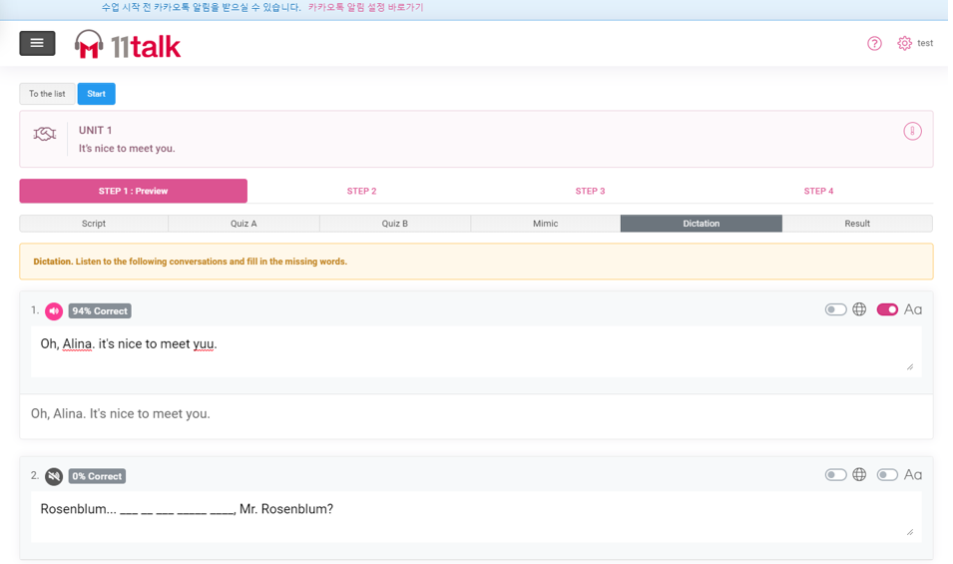
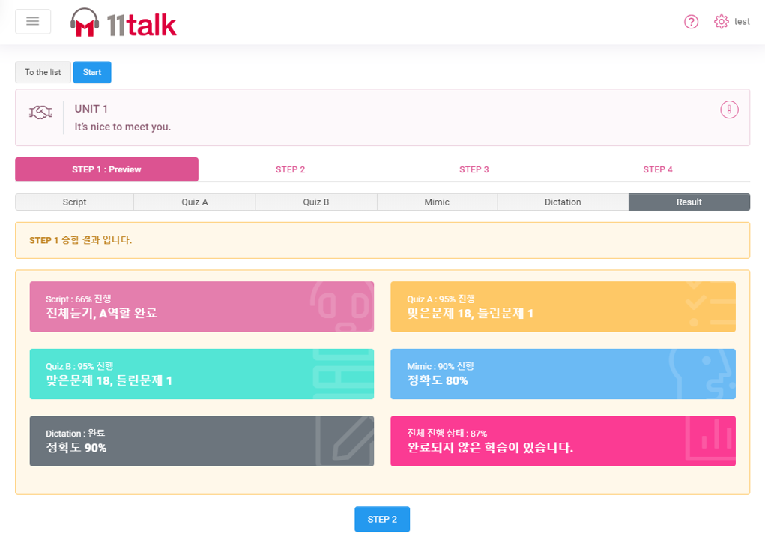

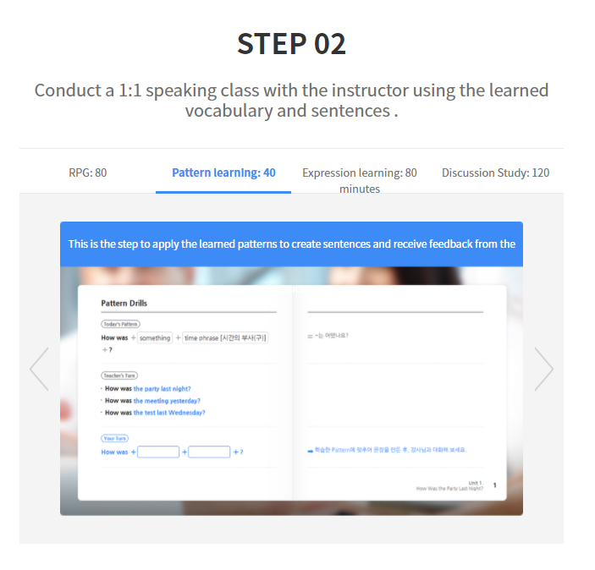
通过听写练习，学习效课会更好
查看你在课程预习中错过的知识点，并确保记住本单元中的新单词和新表达方式
retention is more effecti by answering the dictation exercise.
Check the things you have missed from your lesson preview and make sure to remember the new words and expressions from the unit

Slide 5
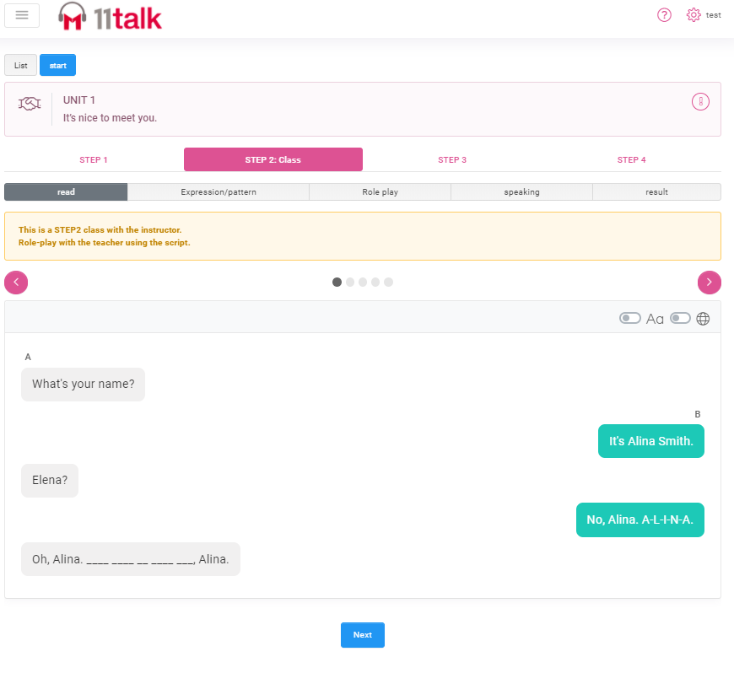
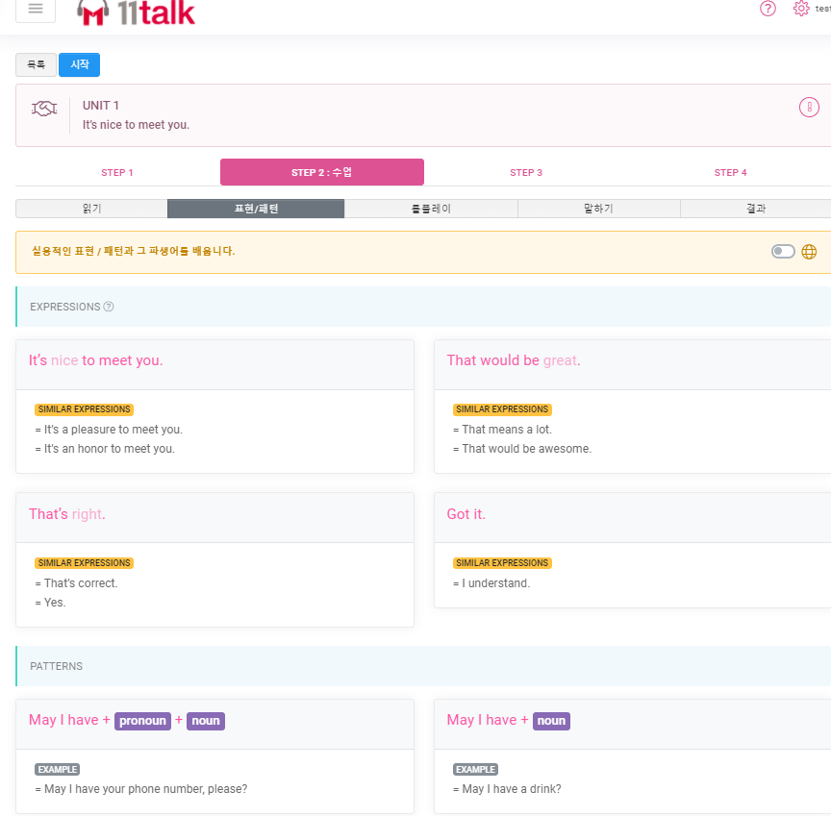
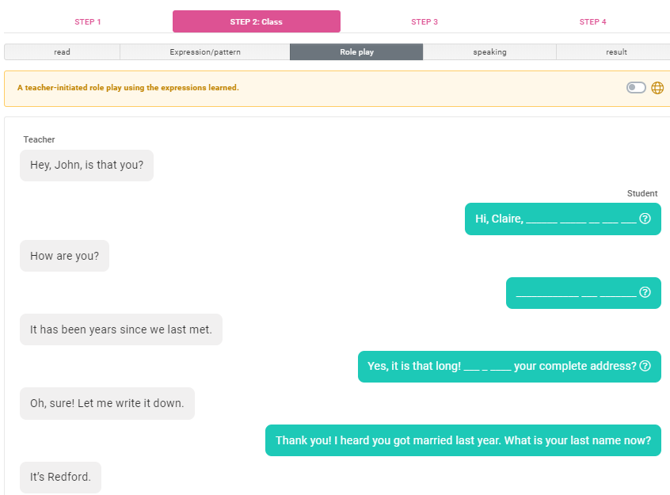


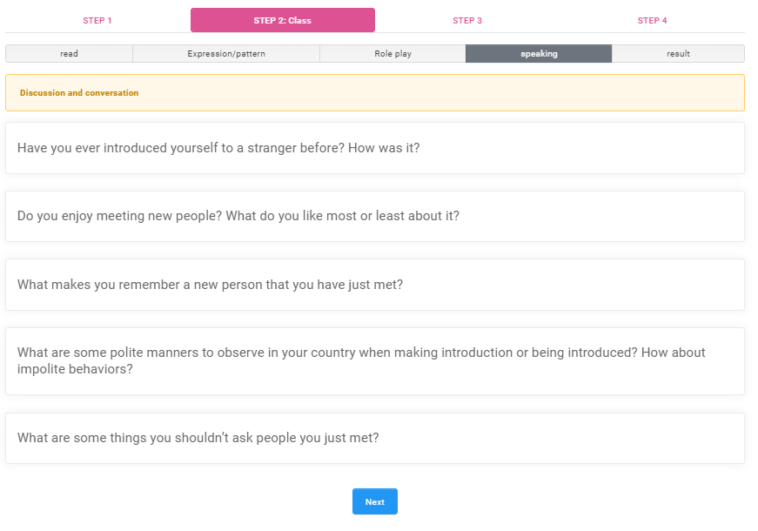
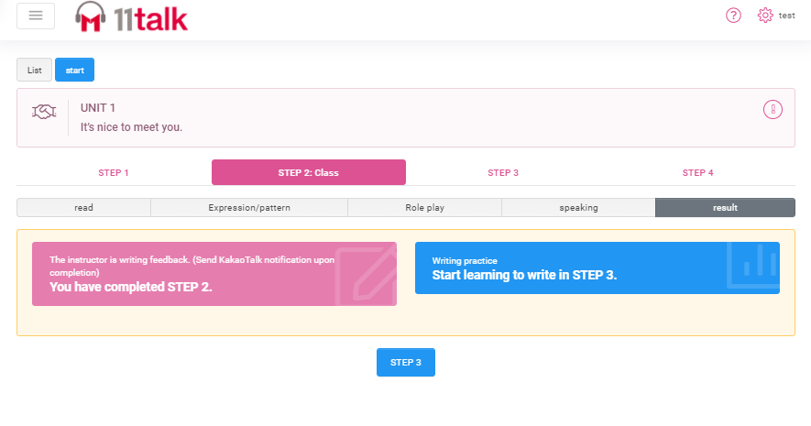

第2步（與您的老師一對一上課）：與您的線上英語老師一起在課堂上使用所學到的單詞和表達式
通过阅读课程，与1：1老师练习口语和发音
Practice accent and pronunciation with your 1:1 Teacher by reading the lesson script.
Learn practical expressions/patterns and similar expressions for everyday use
Engage in activity with your teacher through the role play section
学习日常使用的实用表达式/模式和类似表达式
通过对话练习的部分与老师进行互动
通过在课本中所学到的知识来加强记忆
通过使用实用的表达方式来回答老师的问题，以达到流利使用程度
Seal in what you have learned by using it on your written output.
Gain fluency by using the practical expressions and patterns in answering your teacher’s questions.

Slide 6
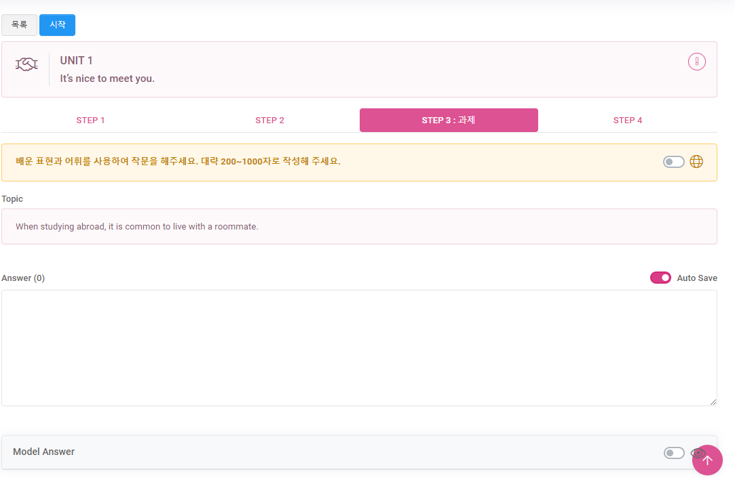
步驟3（作業）：通過完成作業，並從中使用學到的表達方式和詞彙量，讓自己多做些練習

Slide 7
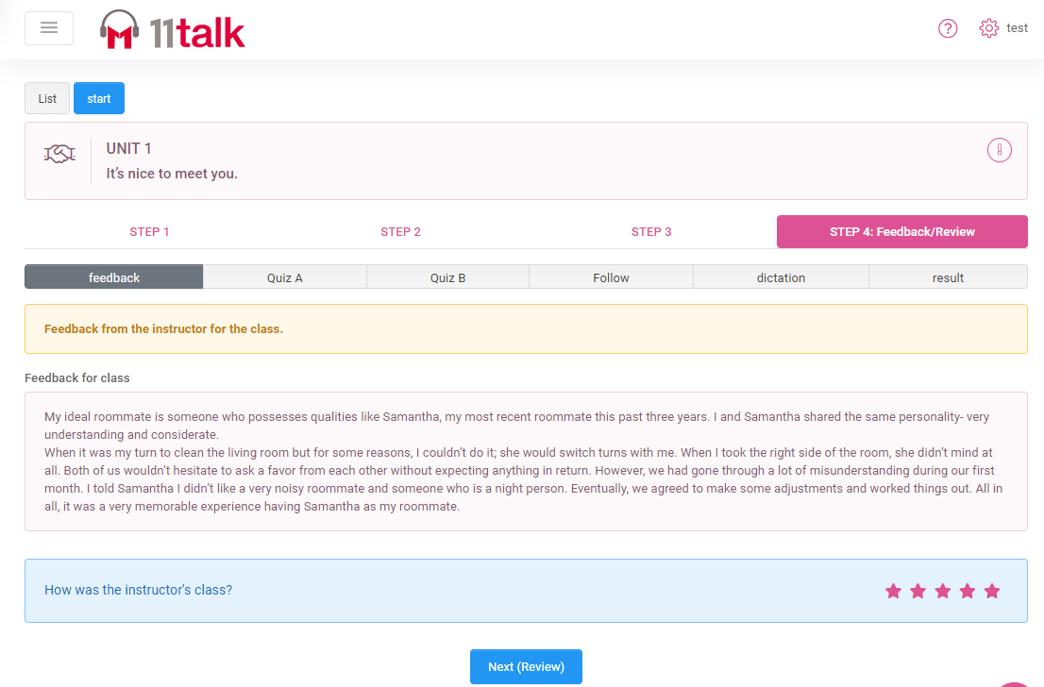
第4步（課後複習）：關看您的每日課堂反饋，並複習老師的評論和建議。再次作答A和B的測驗，模仿聽寫練習，然後看看您錯過了什麼。

